Slide 1

Direct Indirect Speech
We will learn grammar today.

Slide 2
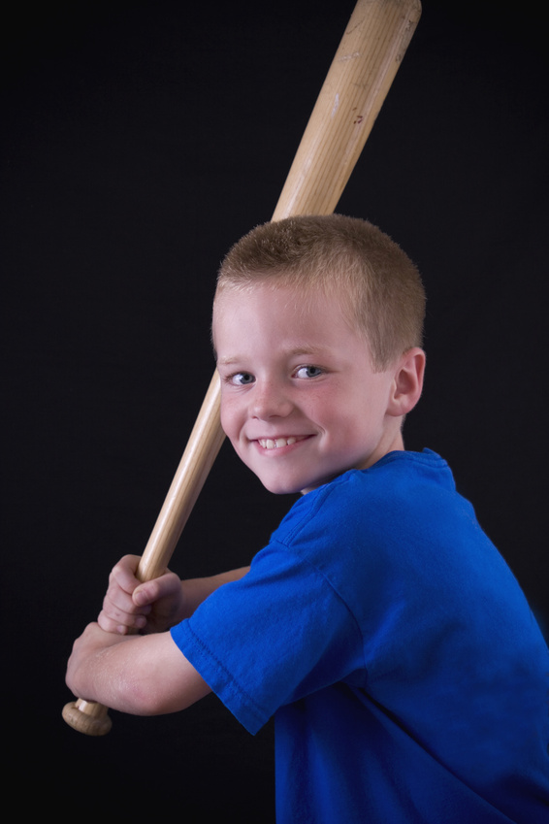
He said, “I am playing.”
He said that he was playing.

Slide 3

She said, “ I am painting.”
She said that she was painting.

Slide 4
He said, “I did this exercise last night.”
He said that he had done that exercise the previous night.

Slide 5
The inspector said, “ I am glad to be with you today.”
The inspector said that he was glad to be with me that day.

Slide 6

What changes did you notice?
Omission of commas
Use of ‘that’
Change of pronoun
Change of tense
Change of adverb

Slide 7

A SPEAKER’S word can be reported in two ways:
Direct Speech- Exact words of speaker
The teacher said to Rajesh, “You have a bright future.”
Indirect Speech- What the speaker has said without using the exact words
The teacher told Rajesh that he had a bright future.

Slide 8
Change of Tense

Slide 9
If the reporting verb in the direct speech statement is in present tense or future tense, then it remains same in indirect speech too i.e. no change in tense.
My friends say, “He is very handsome.”
My friends say that He is very handsome.
My Granny will say, “You need to eat well.”
My Granny will say that you need to eat well.

Slide 10

If the reporting verb is in the past tense in the direct speech statement ,then the verbs within the inverted commas will undergo corresponding changes in the indirect speech statements.
Simple Present becomes Simple Past
The girl said, “The flower is pretty.”
The girl said that the flower was
pretty.
Present Continuous becomes Past Continuous
The old man said, “The rain is falling very heavily.”
The old man said that the rain
was falling very heavily.

Slide 11
Present Perfect E.g.-The Principal said, “All the students have passed.” | Past Perfect The Principal said that all the students had passed.
Simple Past E.g. - Rohan said. “Sheetal arrived yesterday.” | Past Perfect Rohan said that Sheetal had arrived the previous day.
Modals changes into their past forms E.g. - He said, “She can dance.” | He said that she could dance.

Slide 12

Personal Pronouns change according to :
SON formula
1st person = Subject
2nd person= Object
3rd person= No change
If subject of the quoted words is in 1st person then it will change according to the subject of the reported verb
e.g. - He said to me, “I like coffee.”
He told that he liked coffee.
If subject of the quoted words is in 2nd person then it will change according to the object of reporting verb
e.g. - He said to me, “You look happy.”
He told that I looked happy.
If the subject of the quoted words is in 3rd person then there will be no change.
e.g. - He said to me, “She has already left.”
He told that she had already left.

Slide 13
Subject= 1st Person
I said, “I want to consult my parents.”
I said that I wanted to consult my parents.
You said, “ I want to consult my parents.”
You said that you wanted to consult your parents.
She said, “ I want to consult my parents.
She said that she wanted to consult her parents.

Slide 14
Object= 2nd Person
Anil said to me , “ Your parents are waiting for you.”
Anil told me that my parents were waiting for me.
Anil said to you, “ Your parents are waiting for you.”
Anil told you that your parents were waiting for you.
Anil said to him, “ Your parents are waiting for you.”
Anil told him that his parents were waiting for him.

Slide 15
3rd person= No Change
I said to you, “ He should be trusted.”
I told you that he should be trusted.
She said , “ She is looking for a job.”
She said that she was looking for a job.

Slide 16

Change of Adverbs

Slide 17
Change in Adverbs of Time and Place
This | That
Today | That day
These | Those
Now | Then
Here | There
Tomorrow | The following/ next day
Yesterday | The previous day/the day before
Tonight | That night

Slide 18
Change of Adverbs
He said, “ I shall discuss this matter next week.”
He said that he would discuss that matter the following week.
She said, “ We shifted to this house two weeks ago.”
She said that they had shifted to that house two weeks before.

Slide 19

Interrogative Sentences
What?
Who?
Where?

Slide 20
A Question is changed into a Statement.
In a direct ‘Yes/No’ question , reporting verb is changed into ask/inquire and ‘ if/whether’ is used-
She said, “ Are you writing a poem?”
She asked me whether I was writing a poem.
I said to him, “ Do you know when she will go home?”
I asked him if he knew when she would go home.

Slide 21
In case of question word like who, how, where, etc. –same word is used to introduce the reported speech.
“Where do you live?” she asked me.
She asked me where I lived.
He asked, “How do you write poems?
He asked me how I wrote poems.

Slide 22

Imperative Sentences
Advice

Slide 23
In Imperative sentences, reporting verb is changed into ask/advice/request.
Tense remains the same.
The verb is put in the infinitive ‘to‘.
I said, “ Take your seat.”
I asked him to take his seat.
He said, “ Give me some food, please.”
He requested me to give him some food.

Slide 24


Exclamatory Sentence

Slide 25
In Exclamatory Sentences, reporting verb is changed into exclaimed with joy/sorrow/ anger/surprise, etc. That is used .
He said, “ How beautiful a place!”
He exclaimed with joy that it was a very beautiful place.
Rohan said, “ Alas! His father died.”
Rohan exclaimed with sorrow that his father had died.

Slide 26

Let’s check what you have learnt……

Slide 27
Change the following into indirect speech.
The air hostess said, “ The hijackers tried to frighten the passengers.”
The captain said to his men, “ Stand at ease.”
She said to the wizard, “ Do you believe in ghosts?”
The Principal will say, “Rules have to be followed at any cost.”
The boys said, “ Hurray! Our team won.”

